Slide 1


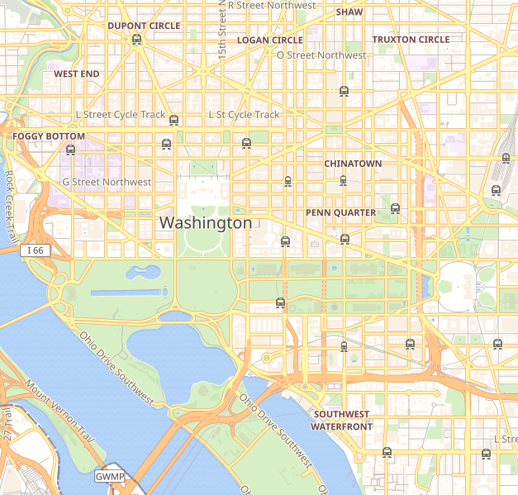

Welcome…
to DC!
Alice
Bob
Notes:
Kyle’s heat map (story)
Did not really explore the city which is a problem that many people face when in a new city. Which leads us to our users

Slide 2



Notes:
Gives (limited) selections for preferences, but is only looking into specific trails it has already in its database

Slide 3
Introducing
Sudarshan Swamy, Kyle Vitale, Luisa Ball, Noah Pritchard
Mentored by Phil Lopreiato
Journey

Slide 4
Find your Journey
DC Travel App
Personalize Routes
Shade
Paved
Points of Interest
Street Lighting
& More!
Notes:
Street Lighting

Slide 5
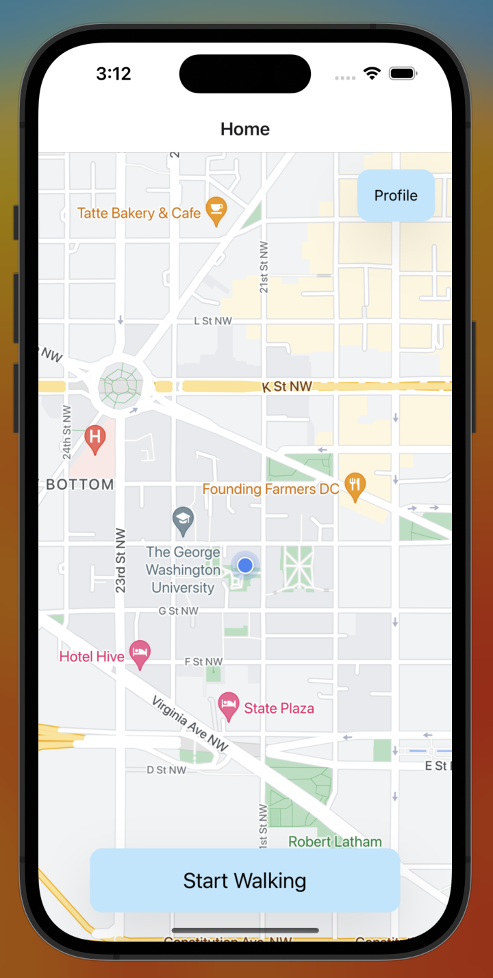
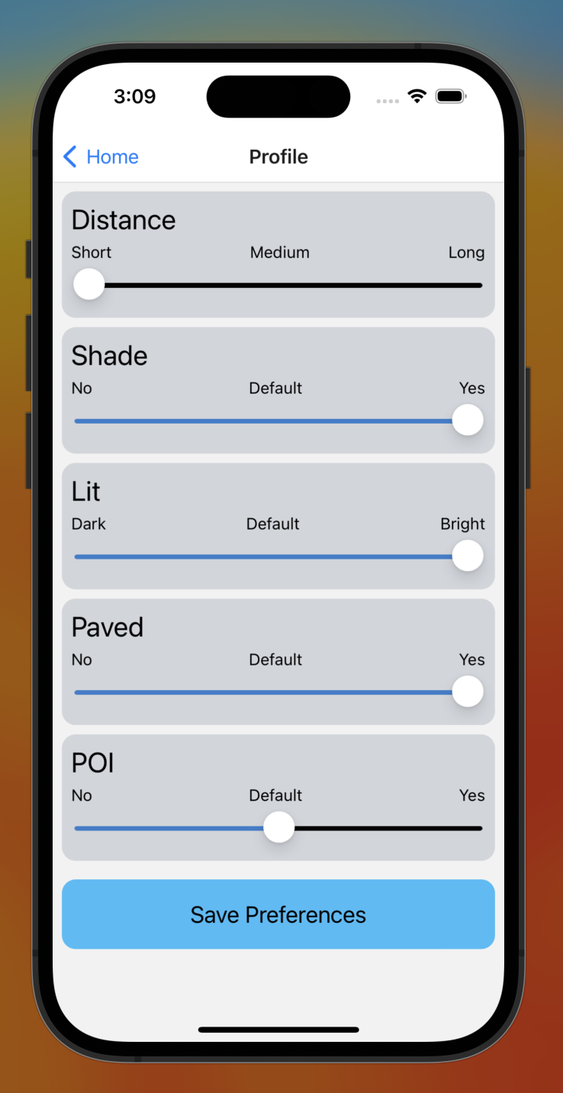
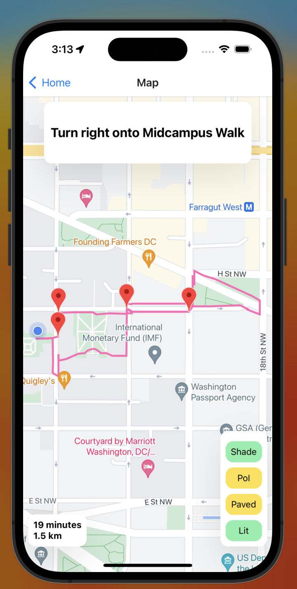
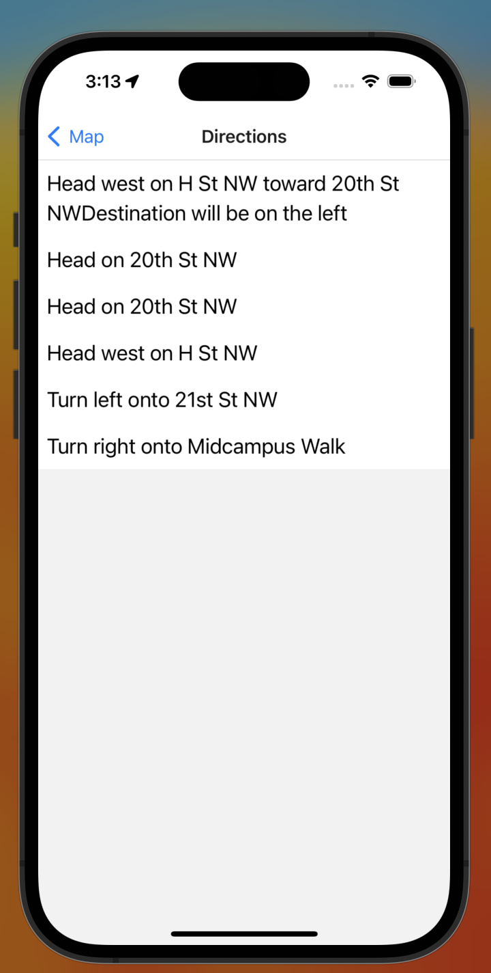
Notes:
Remove user interface
default screen can be less emphasized
better contrast in the background (black/dark backgroudn)
make profile easy to point to
maybe zoom in on map specifically to route, waypoints, and information box

Slide 6



App Framework:
API Services:
Database:
Notes:
increase size of

Slide 7
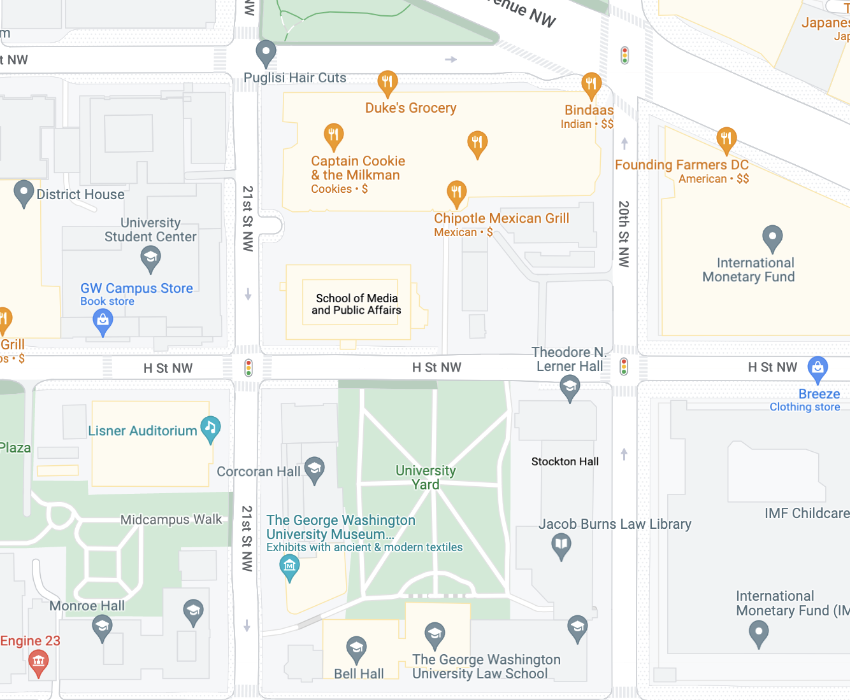
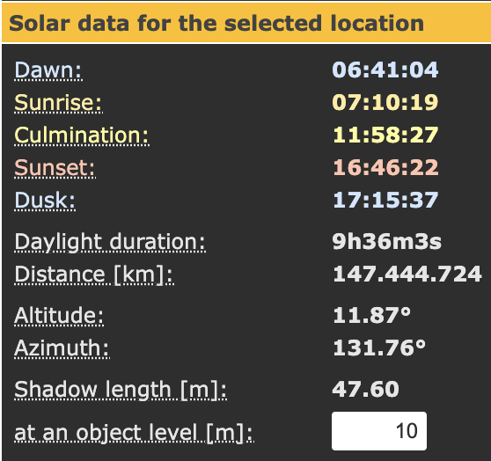
Shading Algorithm
SunCalc:
Notes:
To calculate the shade for our preferences, we created a novel shade algorithm using the SunCalc API.
So how does it work?
So first the algorithm receives the latitude and longitude of a point in the path. It uses suncalc to retrieve the Azimuth which is the angle from where the sun is coming from since we know that all the possible shade will come from that angle.
Then we check points down that line. From each point we check if there is a structure and its height. From there we know that
send s in the lat and log of For shading we receive lat and long of a point in the possible path from the routing algorithm
From there we calculate the angle at which the sun is hitting using the api since we know that the shade will come in at that angle
We do this because it is the angle at which the shadows will hit the point
Then we compute down this line to see if there are any

Slide 8
Notes:
If there is a structure, we use the buildings height to retrieve the shadow length using the suncalc API.
If the shadow length is longer than the distance between the two points then
Places API for Google Maps which has features like place details which we will use to retrieve details about a location
Open source LiDAR map for elevation
For shade suncalc?
GRASS GIS, is a Geographic Information System (GIS) used for geospatial data management and analysis, image processing, graphics/maps production, spatial modeling, and visualization.
SunCalc shows the movement of the sun and sunlight-phase for a certain day at a certain place.
r.sun - Solar irradiance and irradiation model.
Computes direct (beam), diffuse and reflected solar irradiation raster maps for given day, latitude, surface and atmospheric conditions. Solar parameters (e.g. sunrise, sunset times, declination, extraterrestrial irradiance, daylight length) are saved in the map history file. Alternatively, a local time can be specified to compute solar incidence angle and/or irradiance raster maps. The shadowing effect of the topography is optionally incorporated.
encryption

Slide 9
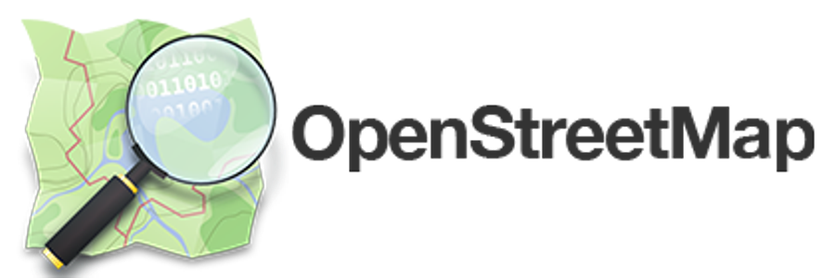
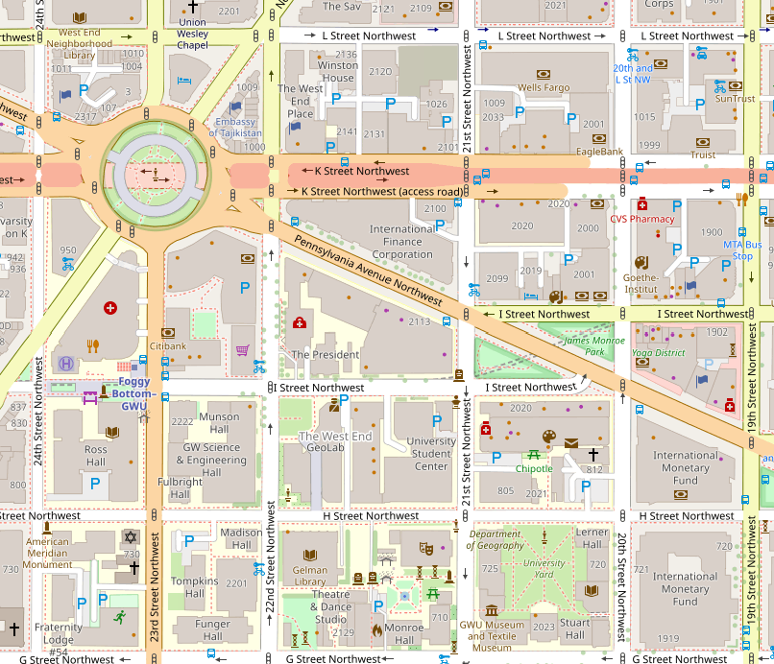
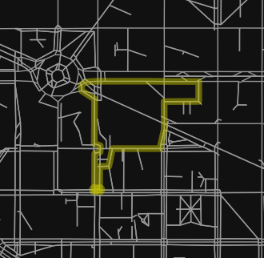
Notes:
Bring in a blank map to compare the before and after
dive more into how open street map was used

Slide 10
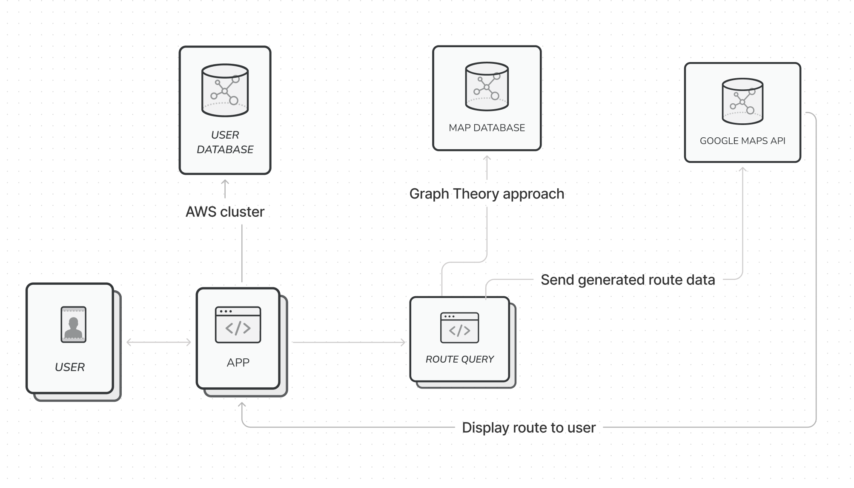

Slide 11
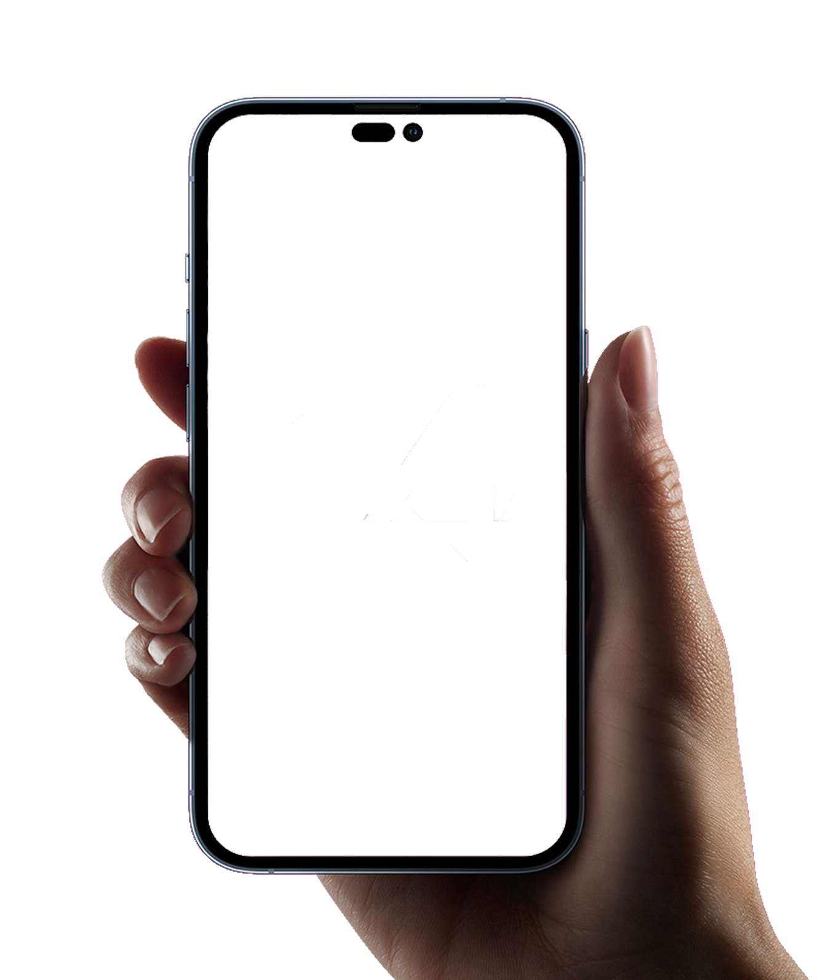


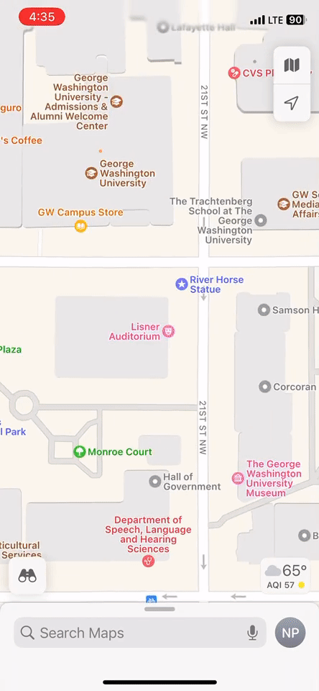
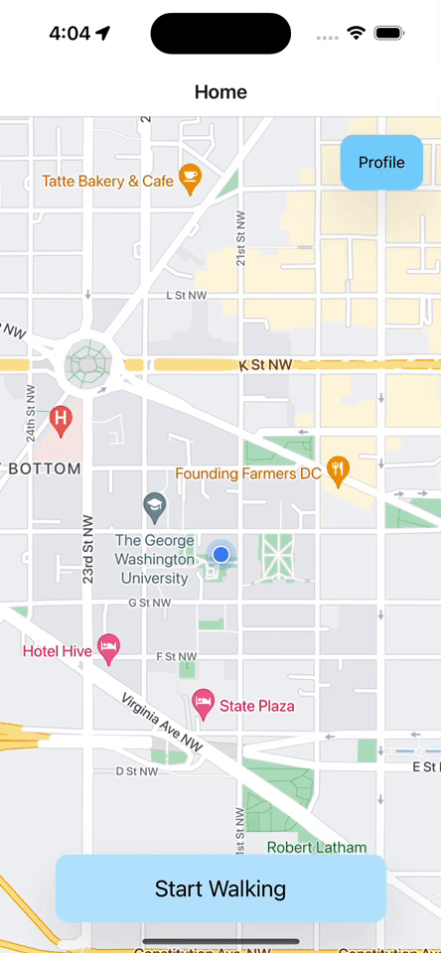
Notes:
where does this leave tourist alice and businessman bob?
compare with google maps

Slide 12
Journey
By Sudhi, Kyle, Luisa, Noah
Mentored by Phil Lopreiato

